Slide 1
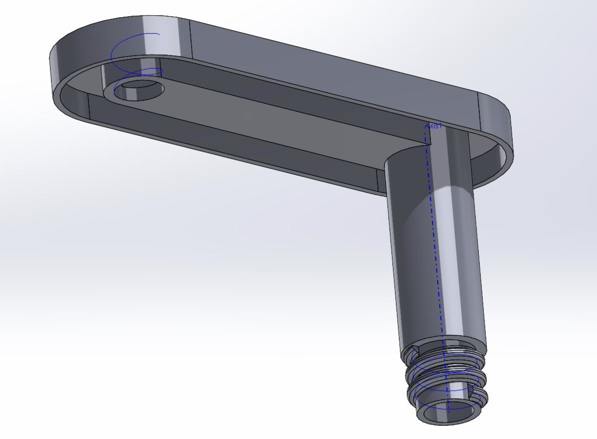
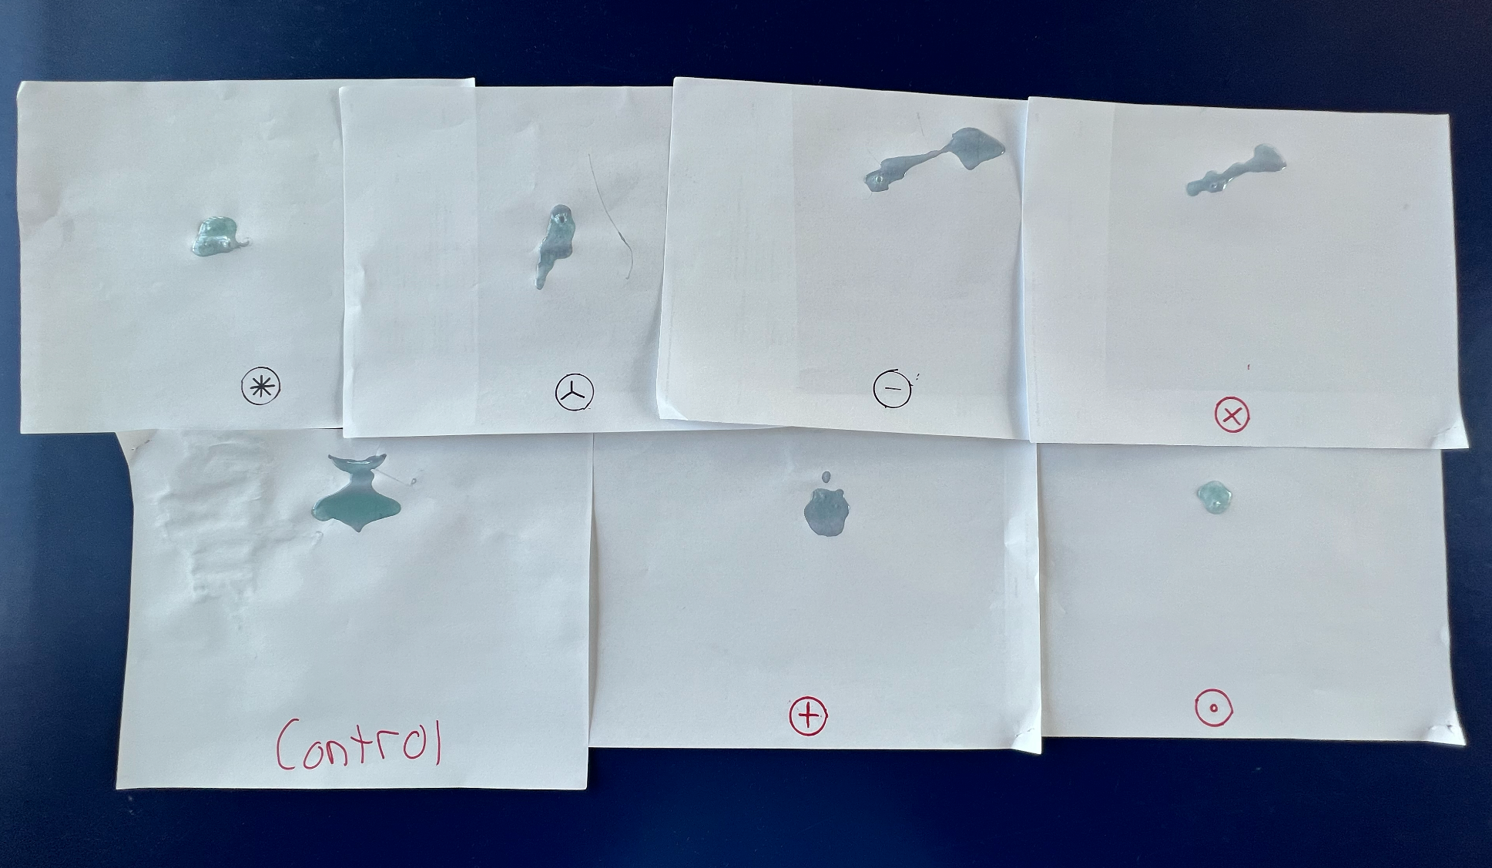
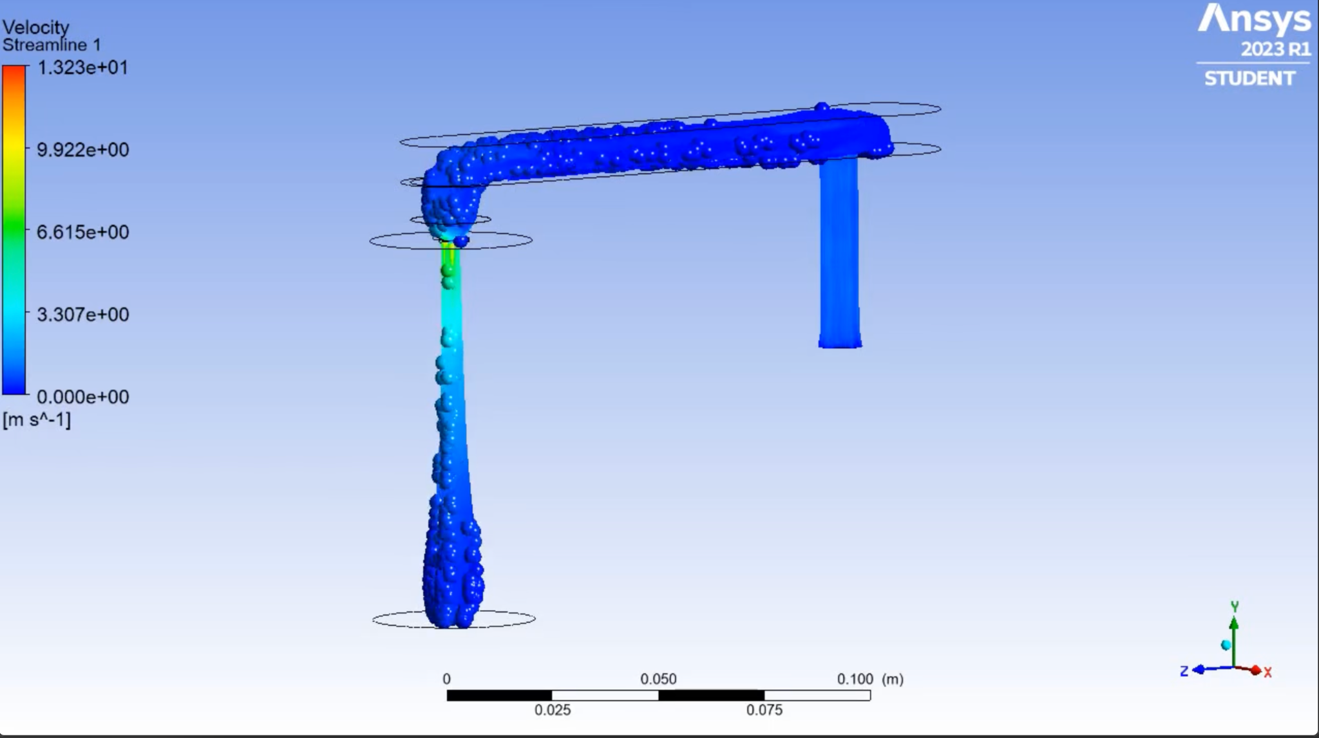
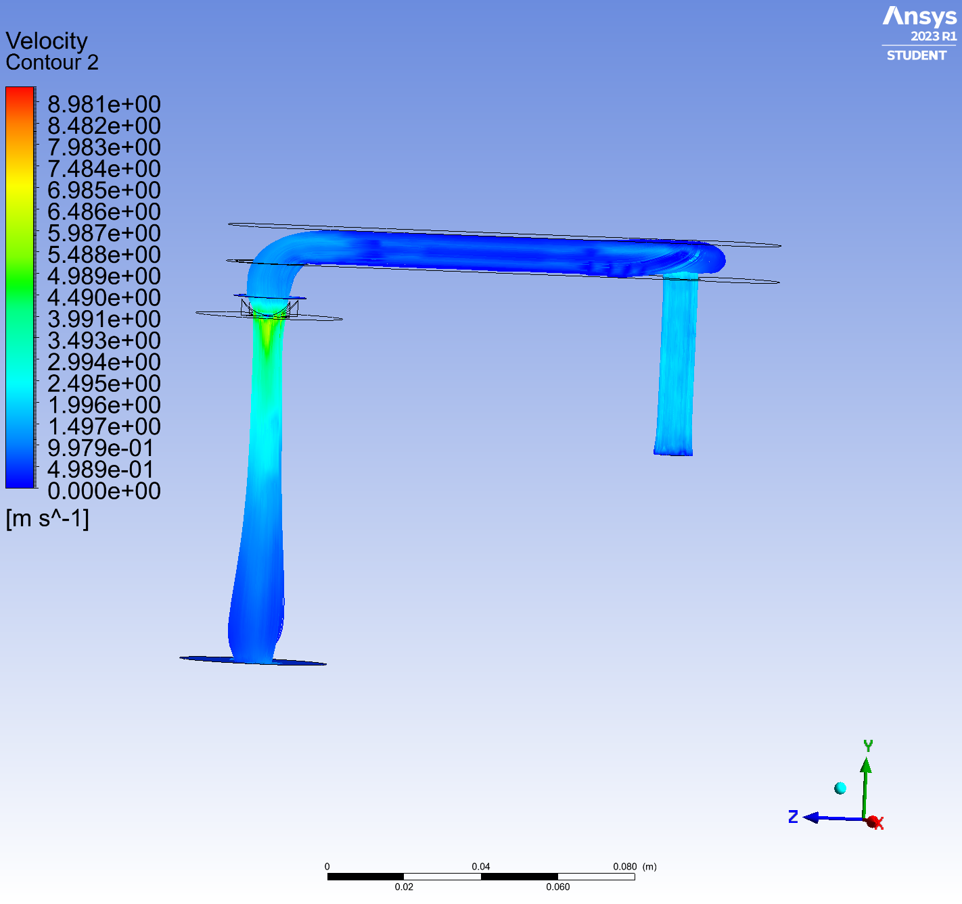
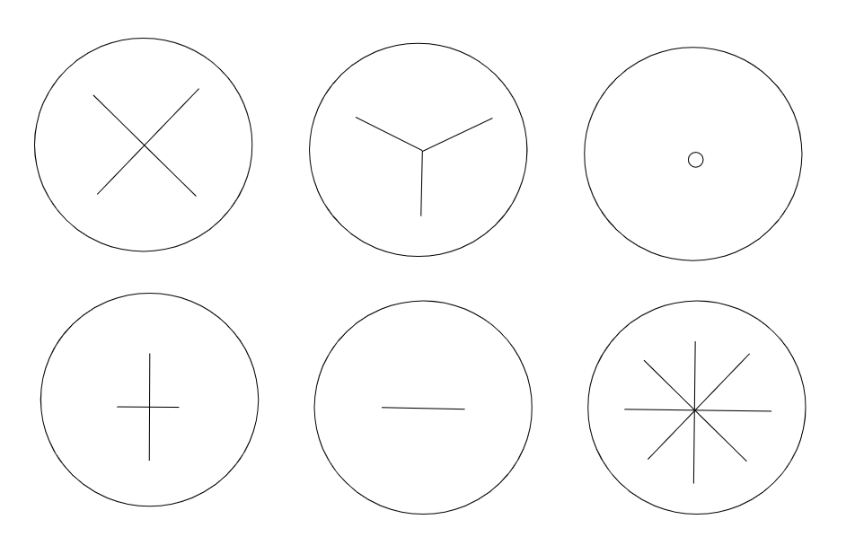
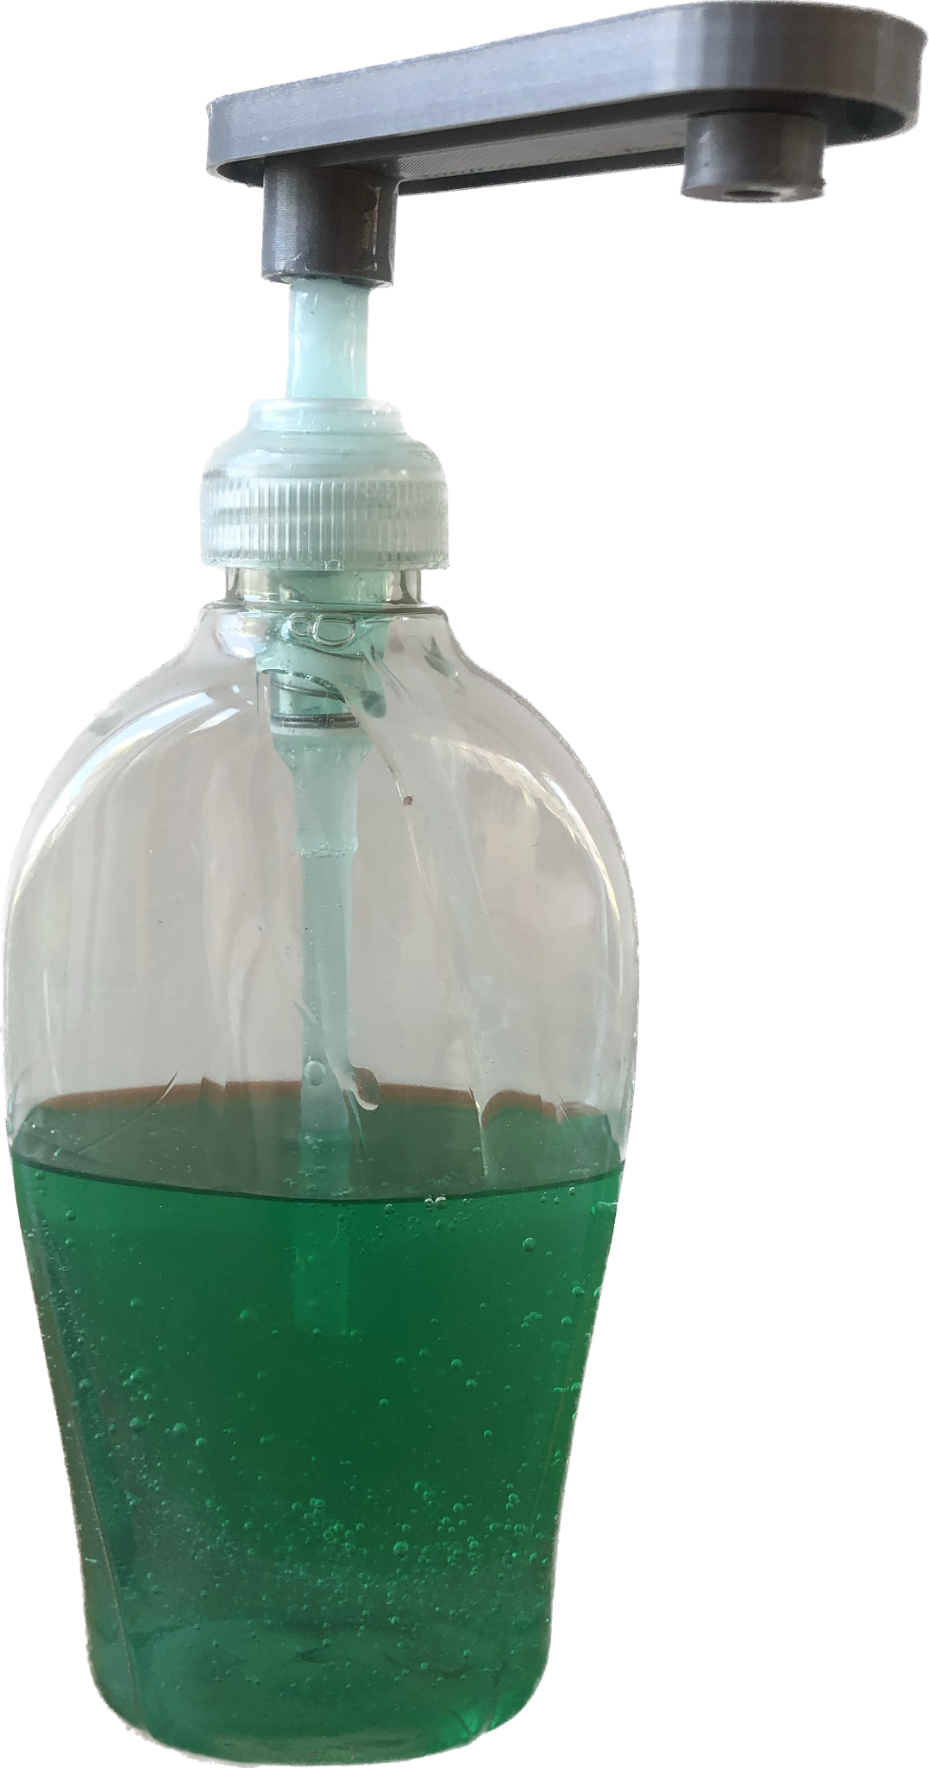
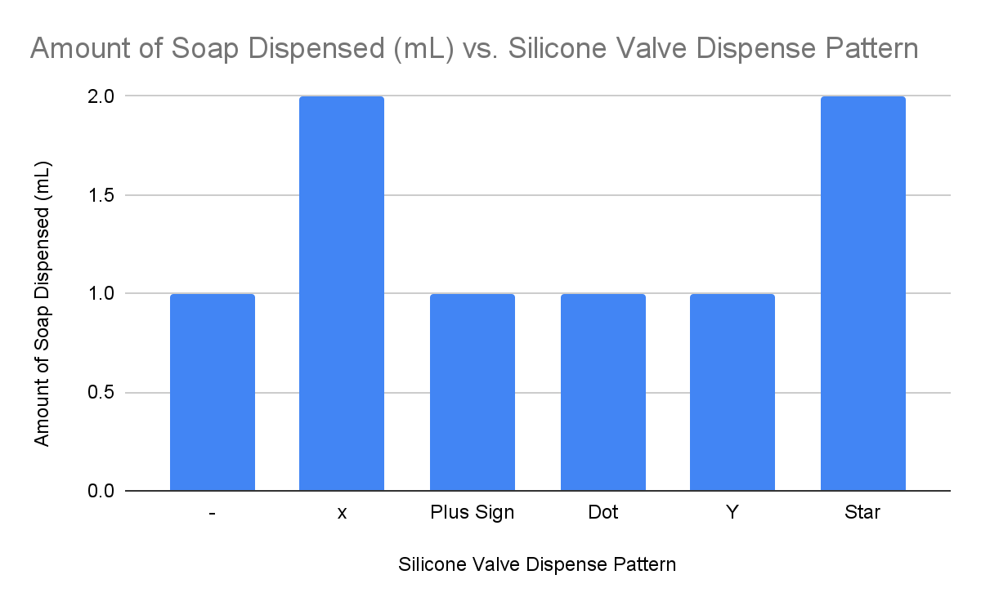
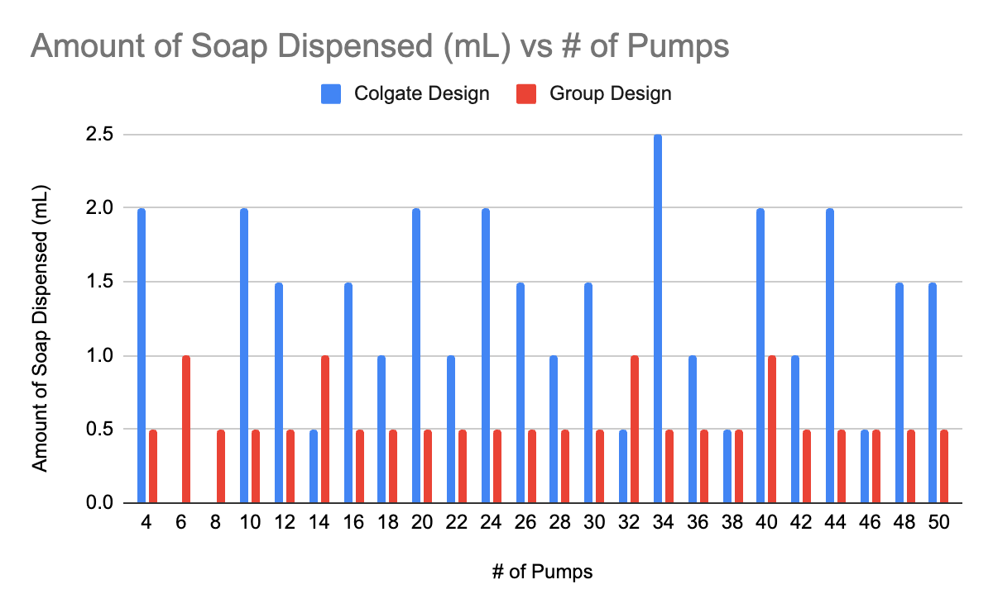
You can move these elements up or down depending on how much text you have. You can also scale it on the right side only.
If your advisor wants to put their lab name on the poster, it should go at the very bottom. Otherwise, that space can be used for more names, etc.
Do not cover or modify this logotype.
Switch this logo out for your sponsor’s logo if you have one, or your advisor’s lab logo if there is one. You can also move it to the left a little and add your logo to its right if you’d like.
Dispensing Pump Project
Joy Best, Gabriela Cortes, Nnadozie Obi, Daniel Kraftmann, Carolyn Nguyen, Estanli Mora-Vargas
Advisor: Professor Gu and Barbara Porter
Introduction
Results
Simulation
Dispensing pumps are used daily for common personal care and beauty products such as toothpaste, soap, and lotion, to name a few. The goal of this project is to design and model a dispensing pump that tackles some of the most common issues of using pumps: clogging and runoff. The motivation behind this project is to develop a new dispensing pump that is not only more efficient but increases user friendliness.
Our design effectively reduces the amount of stringiness (runoff) after dispensing the product. By incorporating a silicone membrane, the opening where product is dispensed is reduced in size and in return slows down the process of oxidation while controlling the amount of product coming out. Our group used the ASTM D4336-18 standard to measure the output per stroke and found that our redesigned pump dispenses an average of 0.5 mL of soap per actuation consistently. In contrast, Colgate's current design exhibited inconsistent dispensing. Also based on testing for the different spray patterns, four out of six designs dispensed 1 mL of product while the other two dispense 2 mL. The different spray patterns can be seen in Figure 4.
We tested our new pump against Colgate's original pump design to compare and contrast the differences. We used Ansys simulation software to analyze the redesigned pump. The simulation results for the redesigned pump, using a more viscous fluid akin to soap and a partially open silicone membrane, exhibited promising outcomes. These assumptions were based on the current knowledge limitations of the simulation software. The simulation demonstrated that there was no apparent stringiness left between actuations when the pump was activated, and the fluid flowed along the flow path. However, the simulation is an ongoing process, and further models will be developed to analyze the performance of the redesigned pump when the silicone membrane is closed and different slit patterns and fluid parameters are introduced.
Design
Our solution to this problem is to first change the profile of the dispense pump nozzle to have an opening at the bottom instead of on the top and on the actuator. Therefore the product is dispensed downward (direction perpendicular to the surface pump is on) instead of outward (direction parallel to the surface that the pump is on) Next, the length of the pump nozzle will be shortened from the existing design in order to minimize product that remains on the silicone membrane after dispensing. Lastly, a silicone membrane is added to the nozzle opening to control stringiness and slow down the oxidation of the product. Inspiration from this was drawn from similar Simply-Squeeze technology.
Figure 2: Pump Nozzle
Figure 3: Silicone Membrane
Figure 8: Velocity Streamline
Figure 9: Velocity Contour
Prototype
Conclusion
Figure 4 : Slit Patterns
Figure 5: Dispense Spray Patterns
Significant conclusions that are made from our design are
1) compared to the original design visible effects of decreased product mess and strigness were produced.
2)Product had a less direct interaction with ambient air flow properties, hence a reduced oxidation and harden product build up compared to original pump design.
3) The design may need further revision to adjust the consumer friendliness when pumping the solution. In our design the product squirts out rather than a softer liquid flow. Our testing with different cut silicone membranes produced conclusive evidence that the thinner silicone membranes the more liquid flow that squeezed out and the softer the liquid pumped out.
Figure 6: Amount of Soap Dispensed for Each Dispensed Spray Pattern
Figure 7: Amount of Soap Dispensed vs # of Pumps
Figure 1: Pump Prototype

